Slide 1
ANDROID
BMI CALCULATOR
GEETHA R
220701073
CSE - E
Page
01

Slide 2



ABSTRACT
This project presents the development of a simple, lightweight Body Mass Index (BMI) Calculator Android application using Kotlin. The app allows users to input their height and weight to calculate BMI and instantly displays their health category—Underweight, Normal, Overweight, or Obese—based on standard WHO metrics. Designed with a clean and intuitive user interface, the application emphasizes accessibility, offline usability, and user engagement through immediate feedback using Toast messages and categorized results. The use of Kotlin ensures more concise, readable code and modern Android compatibility. This project is especially suited for educational purposes and users who require a quick and clutter-free BMI assessment tool.
Page
02

Slide 3


INTRODUCTION
This project is a simple Android-based BMI Calculator built using Kotlin. It helps users calculate their Body Mass Index by entering height and weight, then displays the result along with the corresponding health category. Designed with a clean UI and offline functionality, the app focuses on ease of use, quick feedback, and educational value for learning Android development.
The application categorizes users as Underweight, Normal, Overweight, or Obese based on WHO standards. Kotlin ensures modern syntax and reduces boilerplate code compared to Java. The app is lightweight and does not require an internet connection, making it suitable for rural or low-resource areas. It is also a great starting point for beginners in mobile app development.
Page
03

Slide 4
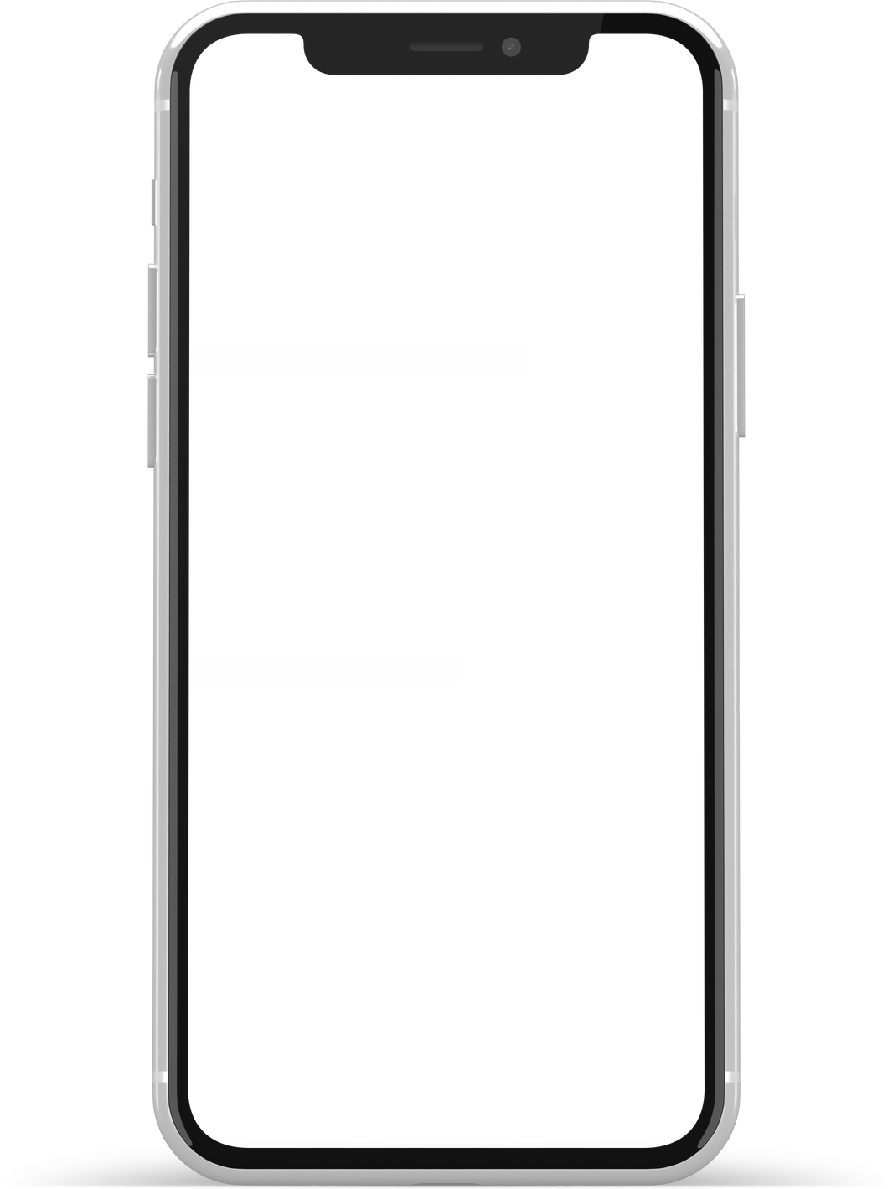
Vision and Goals
To create a simple, efficient, and offline BMI Calculator app for Android users.
Ensure quick health assessments through a clean and user-friendly interface.
Promote awareness of body health categories without internet dependency.
Support learning and practice of Kotlin-based mobile app development.
Page
04

Slide 5




TECHSTACK
Page
05

Slide 6
USE CASES
Personal Health Monitoring
Offline Accessibility
Lightweight Utility App
Helps individuals quickly check their BMI and understand their health status.
Ideal for rural or remote areas where internet access is limited.
Suitable for users who prefer minimal apps without ads or feature bloat.
Page
08

Slide 7
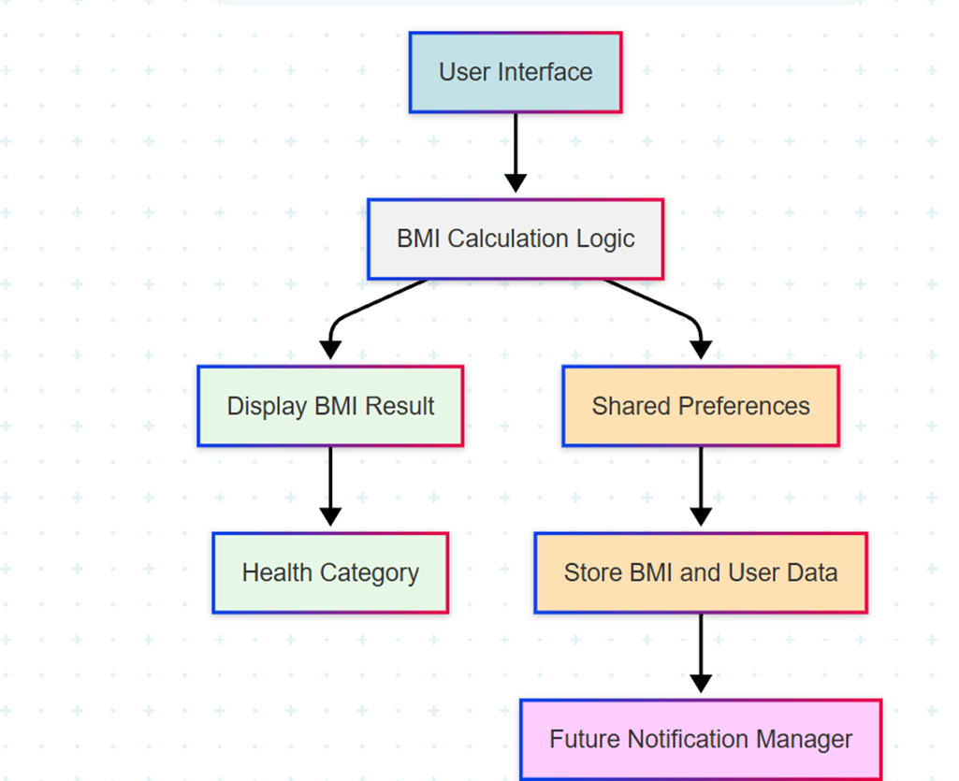
WORK FLOW
User Interface
Users input height and weight through the app's front-end UI.
BMI Calculation Logic
Backend logic processes the inputs to calculate the BMI value.
Display BMI Result
The app shows the calculated BMI on the screen.
Health Category
Based on BMI, it categorizes the user (e.g., Underweight, Normal, etc.).
Shared Preferences
Data is saved locally using Android’s SharedPreferences.
Page
06

Slide 8
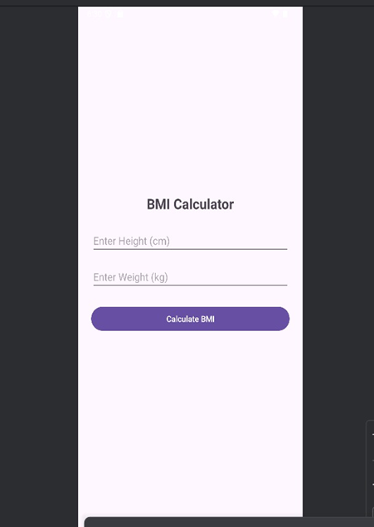
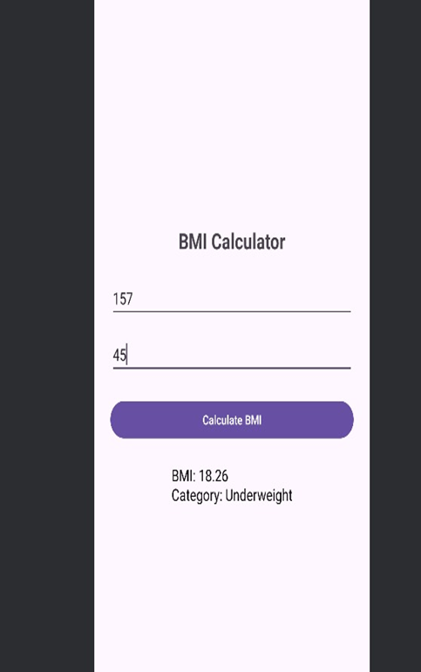

PROTOTYPE
Page
07

Slide 9
CONCLUSION
The BMI Calculator app successfully achieves its goal of providing a fast, offline, and user-friendly tool for calculating Body Mass Index. By using Kotlin and Android Studio, the app maintains clean code and modern development practices. The intuitive interface and instant feedback enhance user experience, making it suitable for both personal health use and educational purposes. This project demonstrates how a minimal yet effective mobile solution can promote health awareness and serve as a foundation for future enhancements.
Page
09

Slide 10
Thank
You.
Page
10

